Slide 1

Preventing Publicly Accessible AWS Resources Design Document
Shekhar Dutta, Cloud Engineer
Altaz Bhanji, Sr. Consultant
Jan. 21, 2021

Slide 2
Recap - Options
 | Approach | Advantages | Disadvantages
1 | SCP / IAM policy with “Deny” when Public IP is required | Trivial to implement For EC2: Instance never starts Prevents access to/from any EC2 instance the Internet | Does not solve the problem directly: still allows EC2 instances in public subnet Condition keys not available with all resources (e.g. will not work with RDS)
2 | Use CloudWatch event to monitor resource startup and shutdown instances in public subnets via Lambda | Solves the problem directly | More time/effort to implement (‘moderate’) Resources will start briefly Applies to broad set of resources
3 | As above, but implemented as Config Rule | As above Can see compliance/non-compliance in config | As above For EC2, requires SSM manager on instance to remediate
4 | SCP with “Deny” when public subnet is used | For EC2: Instance never starts Solves problem directly | Very complex to implement Requires tracking subnet creation/changes and updating SCP (using automation) Condition keys not available with all resources (e.g. will not work with RDS)

Slide 3
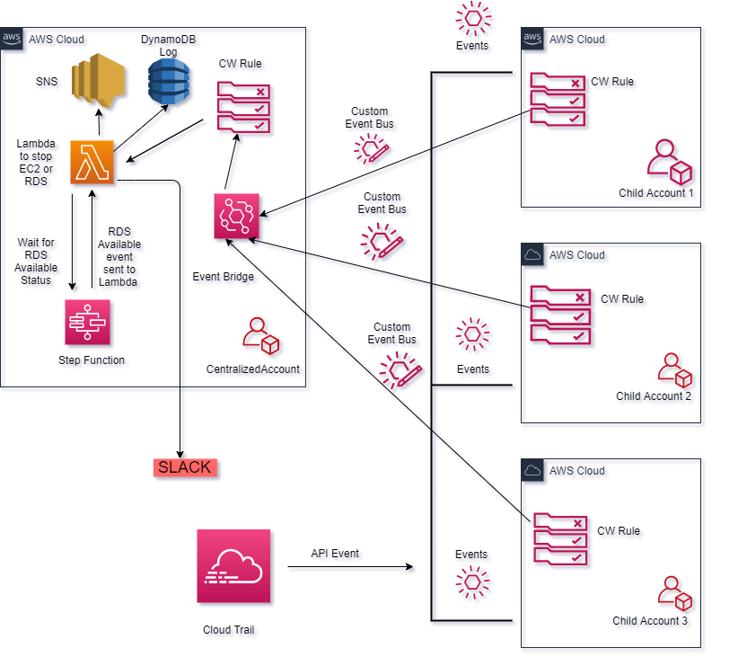
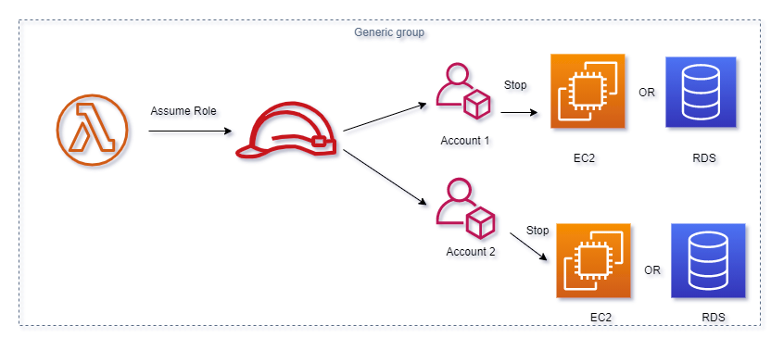
Architecture
After EC2 instance goes into the “running” state, an event is sent via EventBridge to a Lambda function in the master account
The Lambda function :
Gets the instance details
Cycles through the route tables for the subnet
If and ‘igw-’ is found, deemed to be in public subnet
If the EC2 instance is in a public subnet, Lambda function will:
Log the event in DynamoDB
If in compliance mode, will assume a cross-account role into the sub-account and stop the instance
Send a message via SNS
Send a message via Slack
When this is extended to RDS, since there is no event to detect when an RDS instance is running, a step function will be leveraged to create a wait state (prevent 15 minute overrun, not waste money waiting in a lambda function)

Slide 4
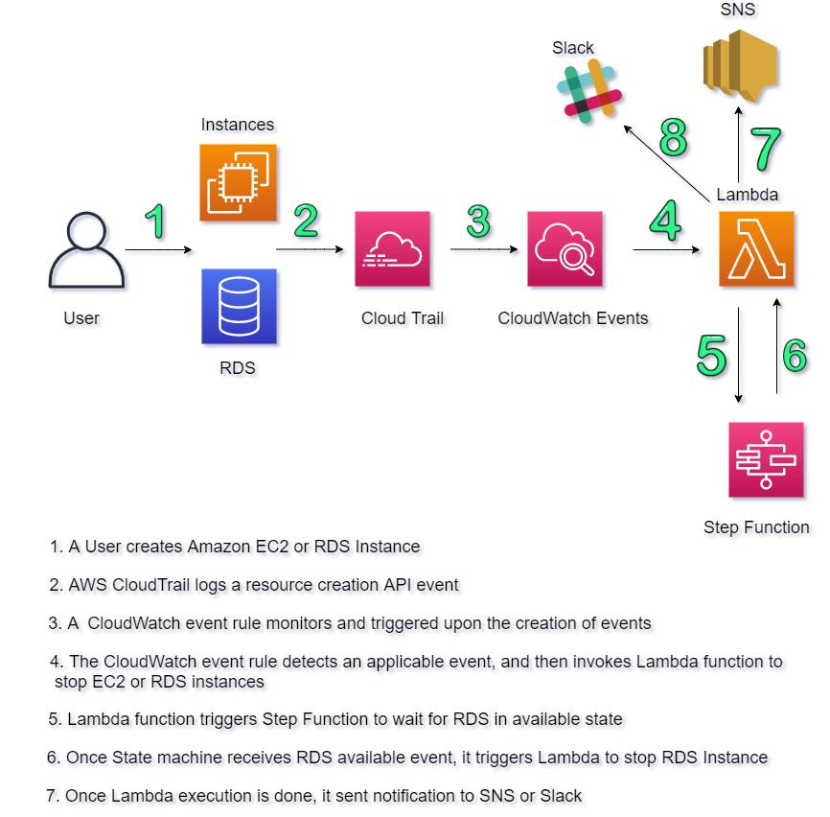
Workflow

Slide 5
Additional Functionality
Audit vs. Compliance Mode
Setup via SSM in master account
Exclusions
Central vs. Account-based
Central: SSM/DynamoDB
Account-based: tagging
Can define OUs, accounts, VPC, subnet, resource IDs in master account SSM / DynamoDB
Alternatively – can use tagging
currently users with specific SAML roles can modify WAF tags; can use the same mechanism
* might be best way to go * (to exclude from OU/account – don’t create stackset instance)
Decision is TBD
Logging shutdowns
By default available in CloudWatch logs for Lambda
Can also create a DynamoDB table, if desired (*)
Test cases
Each time new code is released – run validation tests (e.g. exclusions, etc…)
PR => Lint => Test Cases (AWS code services)

Slide 6
Other Considerations
Deployment
Via stacksets to entire org or specific OU(s)
Single lambda & state machine in central account, cross account roles for children
Release Management
New repo
Work in dev branch and EQ to create pull requests
PR => Lint => Test Cases (AWS code services)
VirtualM (consistent dev environments, libraries, etc…)
Coding Standards
Use Python 3(.8)
Use Boto3 resources over clients where available
Logging can be set to any loglevel (INFO, DEBUG, etc…) in Lambda function
Default: in Python code, reloaded each time Lambda is reloaded (outside default handler)
Q: reload each time? store in environment variable?
=> put inside handler, use environment variable
Visual Studio Code -> standard process for check-in, debugging, etc…

